Slide 1
Spike Model Neural Networks
Listening for Tones
MARKERS

Slide 2
Structure
Inputs
Weights
Potentials
Outputs

Slide 3
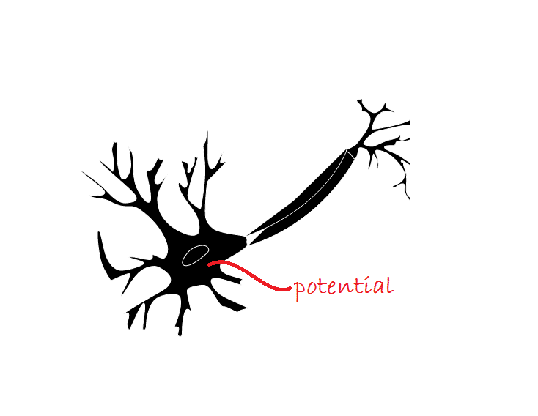
Structure
The potential is the neuron’s internal electrical pressure. It can be positive or negative. When the potential surpasses the threshold the neuron will spike.
The electric potential “leaks” across the cell body. It will therefore decay toward zero over time.

Slide 4
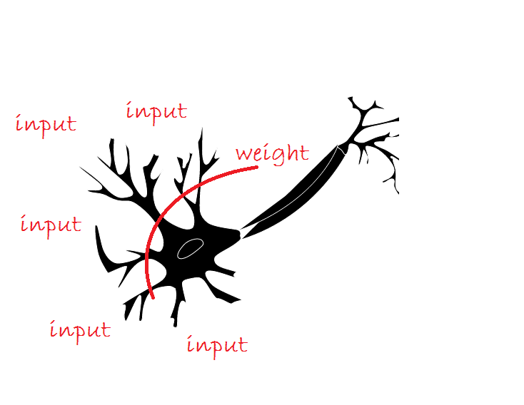
Structure
Inputs can come from other neurons or from sensory input.
Weights determine how much each input influences the neuron’s potential and can also flip the input’s sign.

Slide 5
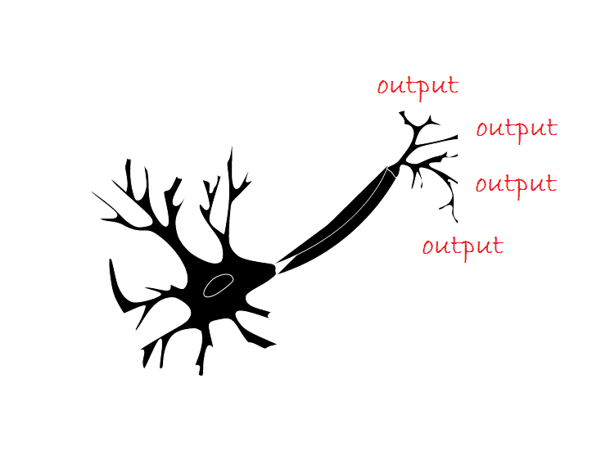
Structure
Output from the neuron is simply a spike. It has a positive or negative direction, but does not contain amplitude information.
After a spike, a neuron will return to a restful state with zero potential.

Slide 6
Simple Examples
Chain of length Three
Chain of Length Four

Slide 7
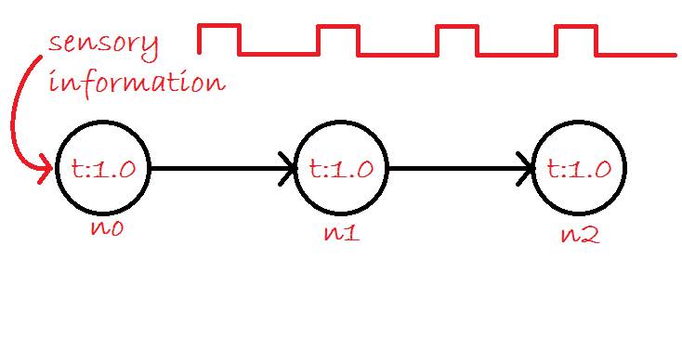
Simple Example
Consider the simple example on the left.
If pulsed sensory information was presented to n0, then it would spike when/if that sensory sum had surpassed the internal threshold of 1.0.
It would then send a spike to n1 which would spike to n2 if the internal potential surpassed the threshold of 1.0.

Slide 8
Simple Example
For this example, let the sensory input cycle on for 5 samples, then off for 10 samples.
It will be easy to see how the potential in the sensory neuron climbs during the on cycle.
As the sensory potential surpasses the 1.0 threshold, it will spike to n1 and the potential of n0 will return to 0.
A further sensory stimulus will again increase the potential, but this will not be sufficient to have n0 spike and it will decay during the off cycle.

Slide 11
Simple Example
We can see the black sensory potential go through cycles of increase, spike, return to zero, increase, decay, and repeat.
The n1 (red) line spikes almost immediately after n0 spikes.
The n2 neuron only spikes every other time n0 spikes. This indicates the diminishing value as information spikes travel through the network.

Slide 12
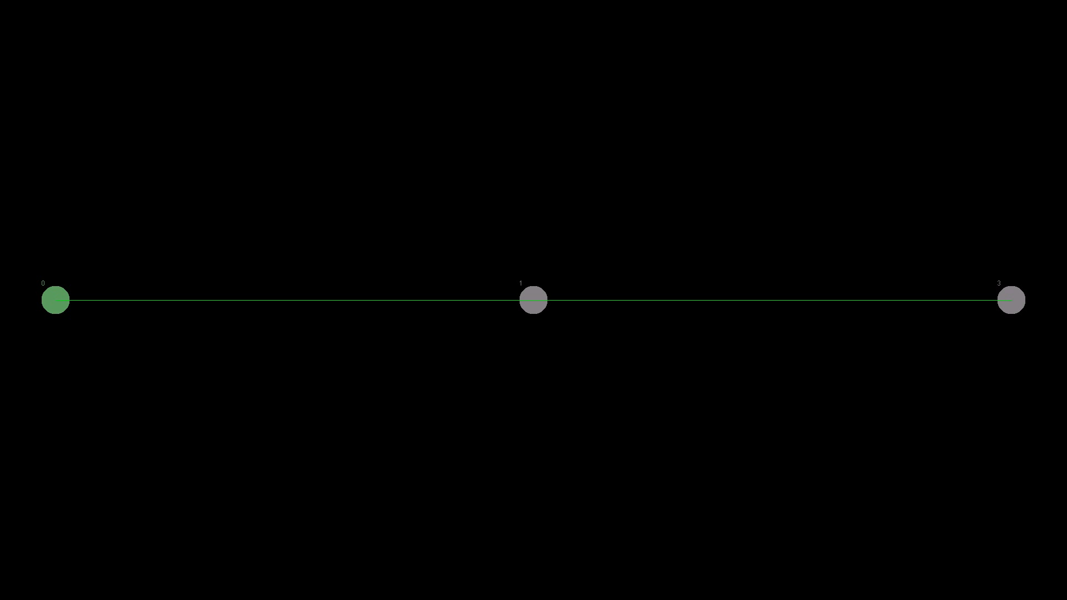

Slide 13
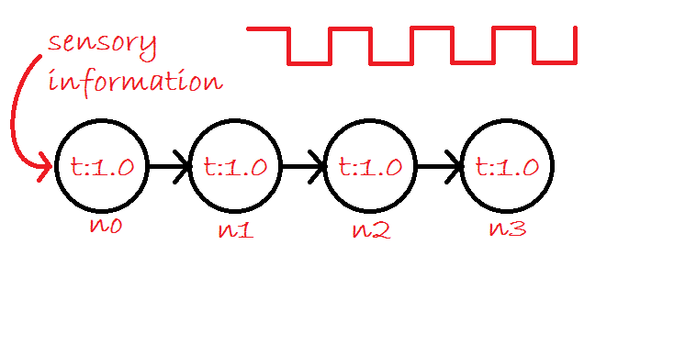
Simple Example 2
As a second example, we add a fourth neuron to the end and change the duty cycle to one half (4 on, 4 off) for the sensory neuron.

Slide 16
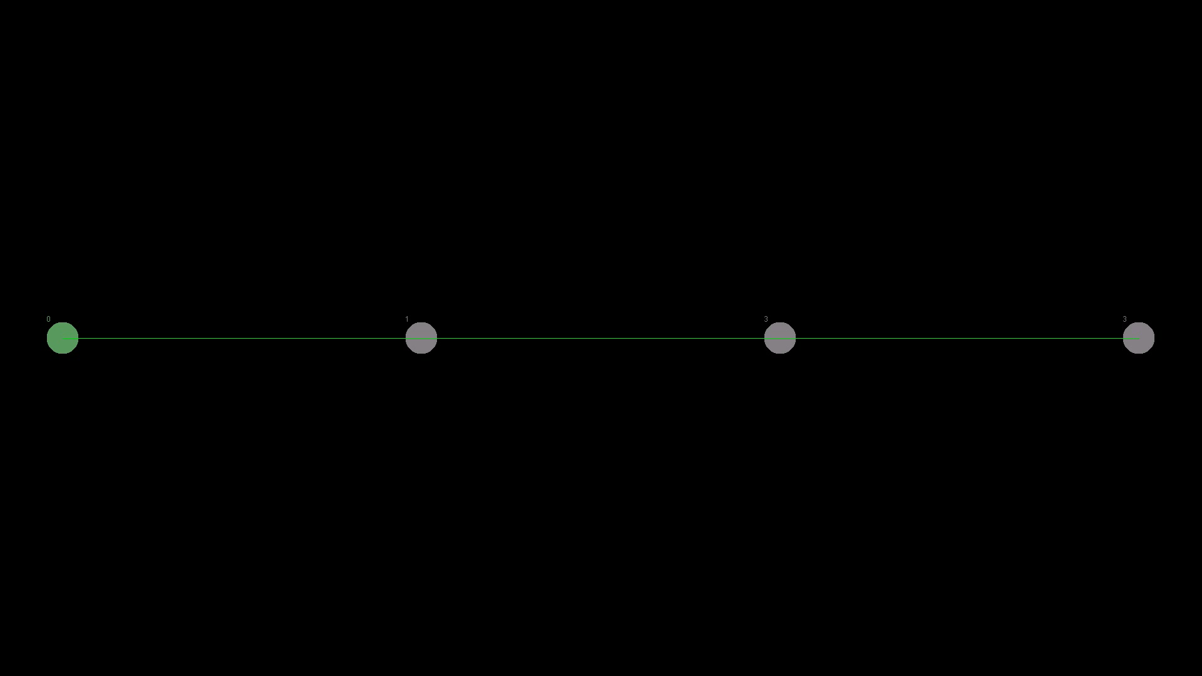

Slide 17
Learning
What learning means
Propagation of lessons learned
Switching Signs
One phase of learning
The learning cycle

Slide 18
Learning
We want to be able to identify input data presented to the neural network.
This means that when we present the neural network with some particular input time data, it should excite particular neurons.
Given random input connections, input weights, and thresholds, it is unlikely the neural network will perform the task
The network must be taught how to respond to the input we determine as interesting.

Slide 19
Learning
One way to achieve this learning is to have an outside mechanism repeatedly present input data and tell the neuron(s) that should be excited to get excited.
If a neuron should be excited, then it should increase the influence of neurons that would have recently helped contribute to the desired excited state.
If an input neighbor neuron recently had a spike that contributed to the desired response of the learning neuron, then that neighbor’s influence should increase.
Similarly, if an input neighbor neuron recently had a spike that was counter to the desired response of the learning neuron, then that neighbor’s influence should decrease.

Slide 20
Learning
If an input neighbor recently had a positive spike and the learning neuron has a positive input weight associated with that neighbor, then the neighbor had a positive (not necessarily good) influence on the learning neuron.
If the learning neuron should be having a positive spike (or at least a large positive potential) then this input spike was helpful, and the neighbor neuron’s influence (weight) should increase.
If the learning neuron should be having a negative spike (or at least a large negative potential) then this input spike was harmful, and the neighbor neuron’s influence (weight) should decrease.

Slide 21
For each input spike that occurred recently
Learning neuron should have large positive potential
Input spike was positive
Input spike was negative
Learning neuron should have large negative potential
Input spike was positive
Input weight is positive
Input weight is negative
Input weight is positive
Input weight is negative
Input spike was negative
Input weight is positive
Input weight is negative
Input weight is positive
Input weight is negative
Contribution positive
increase influence
Contribution negative
decrease influence
Contribution negative
decrease influence
Contribution positive
increase influence
Contribution positive
decrease influence
Contribution negative
increase influence
Contribution negative
increase influence
Contribution positive
decrease influence

Slide 22
Learning Additional Rules
Switching the sign of an input weight if it goes too low. For example, if a neighbor was consistently sending spikes that were bad for the learning neuron (given its current weight), than switching the sign would be good for the learning neuron, and that harmful neighbor that became a very quiet neighbor could then become a helpful neighbor.
Propagation of learning. If a neighbor has been helpful in achieving the desired state in the learning neuron, let the neighbor know! “I was able to correctly spike (pos/neg) because of your help! Please keep up the good spiking!” This allows the neighbor to also learn how to be better at what it was doing. For efficiency, this propagation should not go more than a few layers deep, especially when cycles are introduced.

Slide 23
Learning Video Notes
The sensory neurons are receiving:
4 cycles on and 12 cycles off
The top (n0) is “on” 0, 1, 2, 3
The bottom (n1) is “on” 8, 9, 10, 11
The right neurons are trying to
Spike positive when n0 is on
Spike negative when n0 is on
Spike positive when n1 is on
Spike negative when n1 is on
The neurons that are trying to spike negative still started with positive input weights. Those weights will need to decay toward zero, and then flip sign before the neuron learns how to properly spike.
Around frame 180,
8 seconds into the video
After the 12th time of seeing n0 “on”
After they flip sign, they QUICKLY learn how to negatively signal that n0/n1 respectively are on. And from around 25 seconds on, they appear to fire as hard as the positive neurons.

Slide 24
Learning
The potential values of the input sensory neurons for 100 frames.
Each frame the neuron is “on” it receives an input of 0.6. This allows them to spike twice in the 4 frames that they are on.
There is a 4 frame cooldown period so that the sensory neurons don’t step on each other too much.

Slide 25
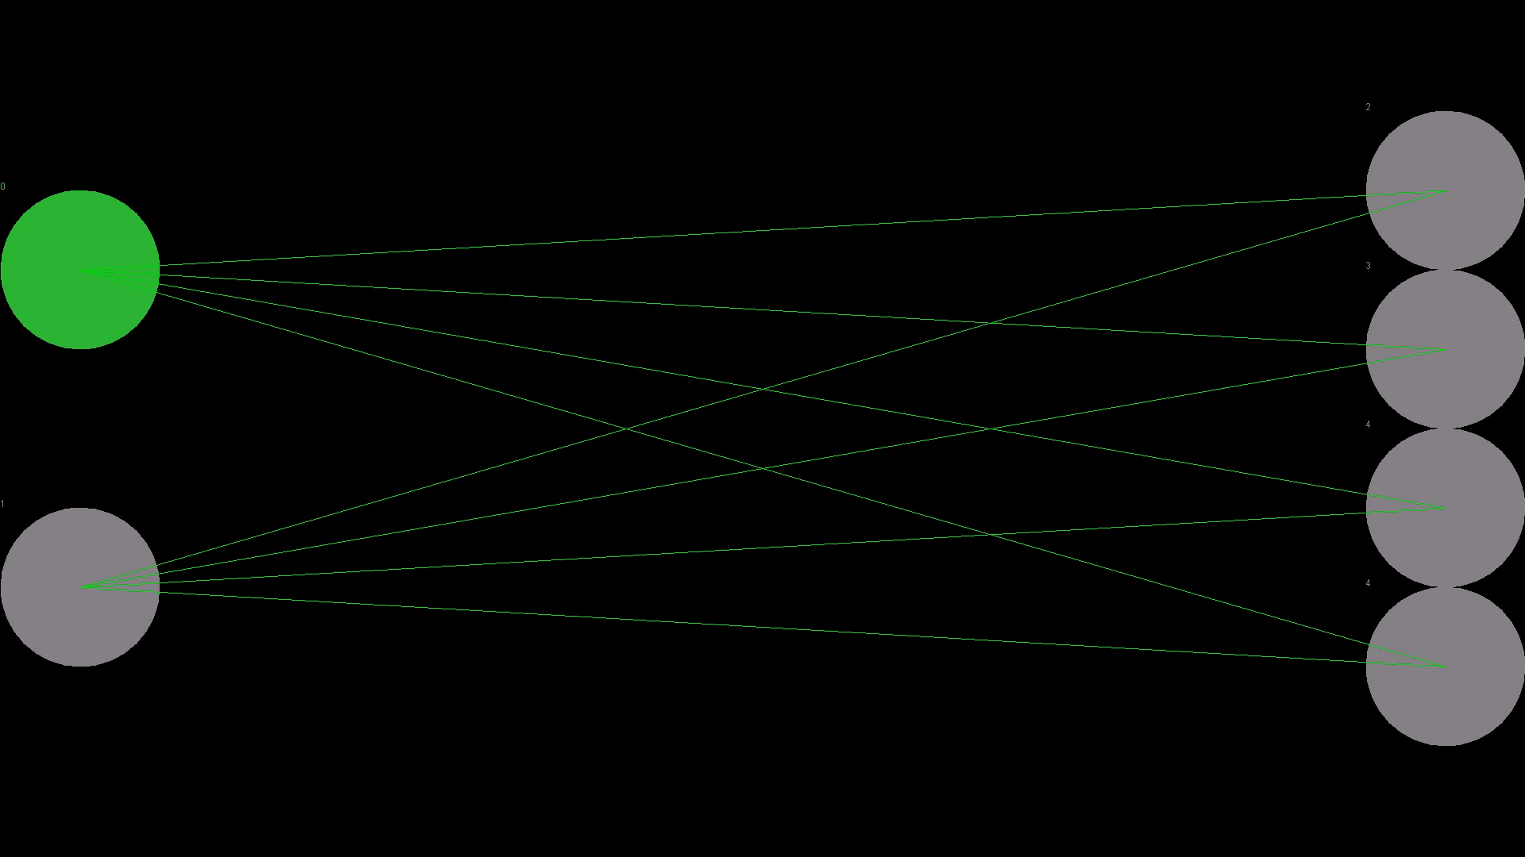

Slide 28
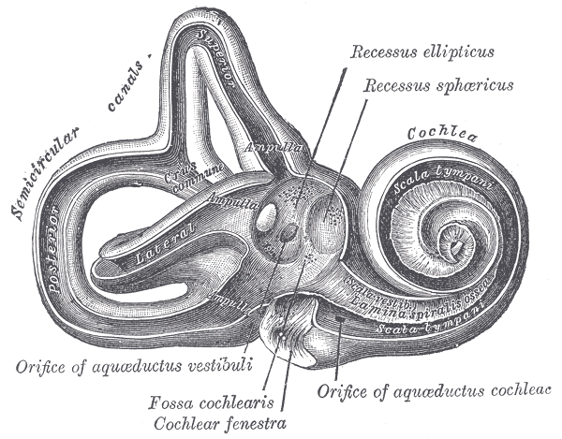
Side Note: The Cochlea

Slide 29
Learning To Identify Music Notes
Simple 2 layer model
Three layer model with more difficult learning

Slide 30
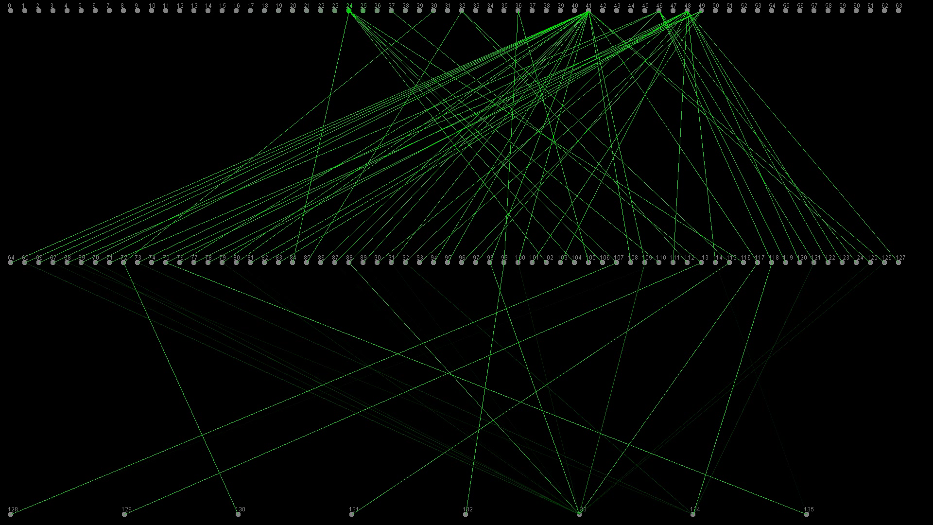

Slide 31
Image Credits
http://www.clker.com/clipart-neuron-in-progress-1.html
https://en.wikipedia.org/wiki/File:Gray921.png

